Slide 1
Youtube Videos' Views
By Davidson Versailles

Slide 2
The exponential growth of video viewing traffic on the internet has led to the rise of the internet economy. Marketeers aiming to promote their content have turned their interest on this fairly new kind of advertisements on videos. Their main concern is that they would only like to promote their content on videos that will be viewed by as many people as possible. This need to be able to know which video is going to attract the more viewers, has made necessary the existence of a predictive mechanism that would be able to predetermine the popularity and virality of videos.

Slide 3
Methodology
1. Data Collection
2. Labeling and Filtering
3. Feature Preparation
4. Development and Fine-tuning of Algorithms
5. Training and Classification
6. Evaluation of Algorithms
7. Comparison of Algorithms
8. Conclusions

Slide 4
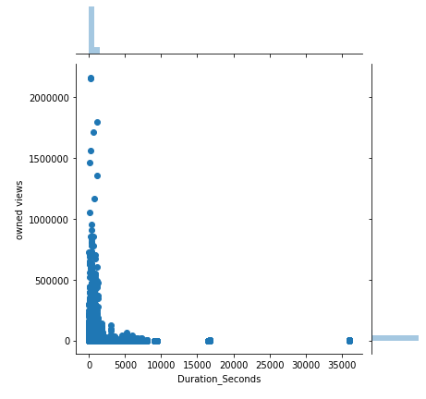
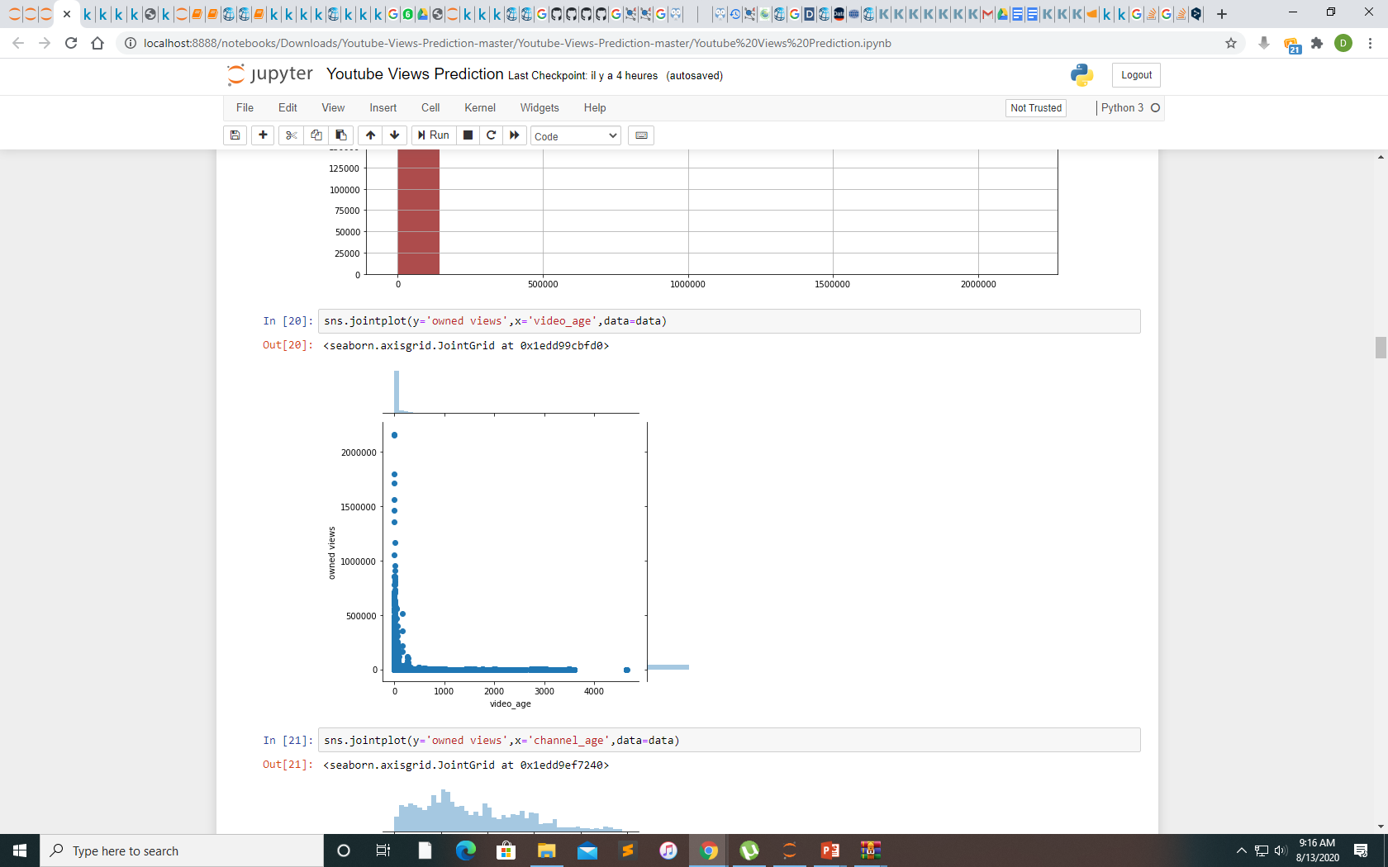
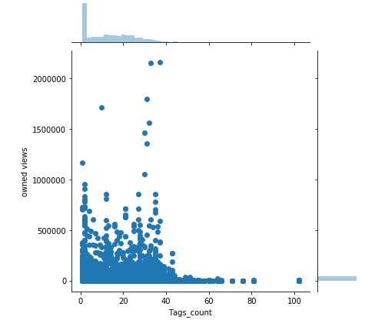
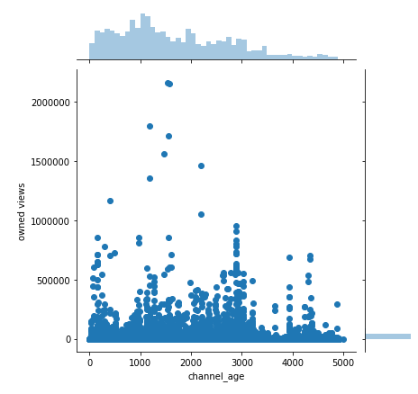
visualisation
As long as the duration of the video is more expensive we have more viewing time.
The videos gain more view depending on the publishing time

Slide 5
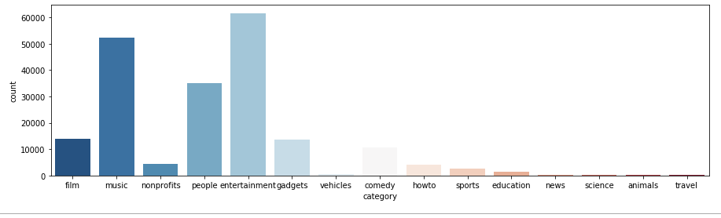
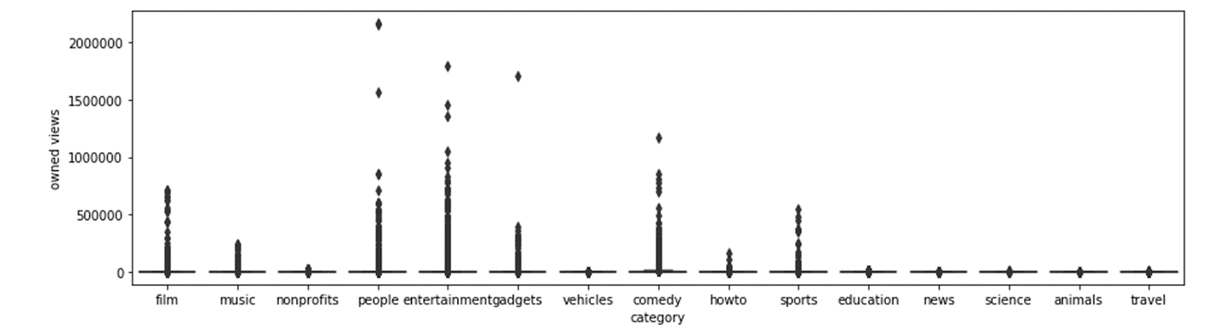
Visualisation by categorie
Nous constatons que toutes les catégories, à l'exception des divertissements, de la musique et des personnes, représentent moins de 7 % du total des observations

Slide 6
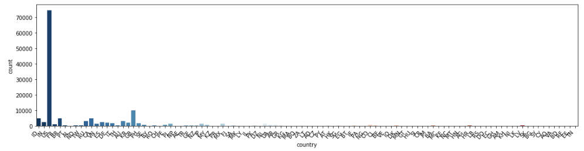
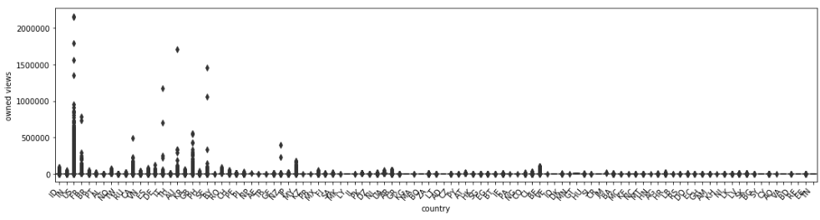
Coutry get most viewing
The united states is the country with the highest visitation rateof the total observations

Slide 7
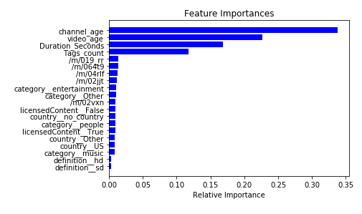
Feature impotant for youtube

Slide 8
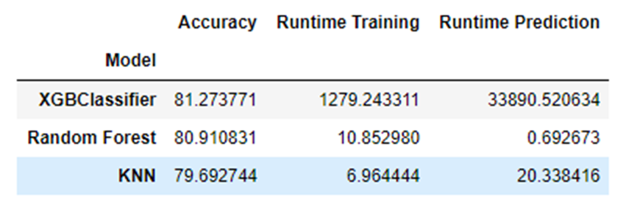
Comparaison
XGBoost's prediction accuracy is: 81.27
Time consumed for training: 1279.243
Time consumed for prediction: 33890.52063 seconds
Random Forest Classifier's prediction accuracy is: 80.91
Time consumed for training: 10.853 seconds
Time consumed for prediction: 0.69267 seconds
KNN Classifier's prediction accuracy is: 79.69
Time consumed for training: 6.964 seconds
Time consumed for prediction: 20.33842 seconds

Slide 9
conclusion
TOP Features
channel frequency
ideo category
title length
tag length
publish hour
Suggestion for Stakeholders
Publish as many as possible videos to arise your channel frequency.
Post in the morning, more specifically earlier than 2PM.
Use less than 2 stop words in tags.
Use less than 10 tags.
Use “official video” as tags if possible.
Categories of 'Film and Animation', 'Music', 'Gaming’, 'People and Blogs', 'Comedy' and 'Entertainment’ usually get more views, try to post videos in these topics!

Slide 10
FUTURE WORK
The topics from the columns topicIds and relevantTopicIds could not be used in our project. To extract the topics we needed to use the Freebase API which had to be integrated with our project code. This was causing few issues as there were a few requisites for the integration. With proper integration and extraction these features can be used in the future expansion of the project.

